Slide 1
INSTRUCTOR:
RAMESH RAJAGOPALAN
WARRANTY DATA
ANALYSIS
Presented by Team 4
SPONSER NAME:
CHANDRAMOULI

Slide 2
TABLE OF CONTENTS
01
INTRODUCTION
02
BUSINESS BACKGROUND
03
BUSINESS CONTEXT
04
PROJECT STRATEGY
05
RECOMMENDATION
06
CONCLUSION
02
page

Slide 3




ABOUT
WHO ARE WE ?
Our team is composed of 6 members, each with a unique background and area of expertise.
We have Anush Bharathwaj, Balamurugan, Dhatchana, Hirthick Raj , Dhinakaran , Abishek and collectively, we have Three Years of experience in CSE and DataScience . Our team has worked collaboratively to ensure that our analysis and recommendations are informed by a variety of perspectives and experiences.
We hope that our research will be informative and thought-provoking, and that it will spark conversations and ideas that will
contribute to ongoing efforts to the project objective. We are excited to share our work with you, and we look forward to your
questions and feedback. Thank you.
IDENTIFY
DEFINE
CONCLUSION
03
page

Slide 4

BUSINESS
BACKGROUND
A warranty is essentially a promise made by the manufacturer to the customer that the product will meet certain standards of quality and reliability.
The data collected from the after-sales (AS) portal is also very important as it provides valuable insights into the current failure modes of the product. By analyzing this data, the manufacturer can identify patterns and trends in the failures, and take appropriate actions to improve the design and manufacturing processes. This can ultimately lead to a more reliable and higher-quality product.
Overall, both warranty and the data collected from the AS portal are critical components of ensuring product reliability and customer satisfaction. It is important for manufacturers to continuously monitor and improve both aspects in order to maintain their reputation and competitiveness in the market.
PROJECT ONE
BUSINESS BACKGROUND
04
page

Slide 5

BUSINESS CONTEXT
PROBLEM STATEMENT
The company is experiencing high warranty costs, a warranty data portal could help identify the specific products or product categories that are driving these costs.
The portal could identify the most common causes of warranty claims and the products that have the highest frequency of claims.
BUSINESS OPPORTUNITY
One potential opportunity is to use the warranty data to identify the most common types and causes of failures in their spare parts.
By analyzing this information, companies can develop new products and services that address these issues, such as more durable or reliable components, or improved installation and maintenance processes.
This can lead to increased customer satisfaction and loyalty, as well as new revenue streams from the sale of these improved products and services.
OPPORTUNITY
05
page

Slide 6




PROJECT
STRATEGY
DATA COLLECTIONS AND CLEANING
DATA EXPLORATION AND ANALYSIS
DATA COLLABORATION
DATA VALIDATION
Check the data for missing or incomplete entries, and determine whether the missing data can be filled in or if the record needs to be removed.
Look for trends in the data, Look for patterns in the data, and Use data visualizations such as graphs, charts, and maps
Identify the stakeholders , Share the data with the relevant stakeholders ,and Encourage feedback from stakeholders on the data
Verify that all required fields are present , Ensure that the data is consistent across all entries, and Verify the accuracy of the data by comparing it with other
06
page

Slide 7

PROJECT
PROCESS
STEP 1
STEP 2
STEP 3
STEP 4
STEP 5
STEP 6
DATA OUTLINE
DATA CLEANING
DATA PROCESSING
DESCRIPTIVE STATISTICS
DATA VISUALIZATION
SUBMISSON AND CONCLUSION
Background information on warranty data of vehicles spare parts, Importance of warranty data for product reliability and customer satisfaction
Preparing the data for analysis, Identifying and resolving data quality issues, Data transformation and standardization.
Identifying stakeholders,
And Encouraging feedback
First Verifying data completeness, Verifying data accuracy, Identifying data anomalies, and Documenting data validation process and results
Identifying trends and patterns in the data, Calculating key metrics,
And Creating visualizations
Summary of key findings,
Implications for product design, manufacturing, and quality control, and Future directions for data collection and analysis
07
page

Slide 8
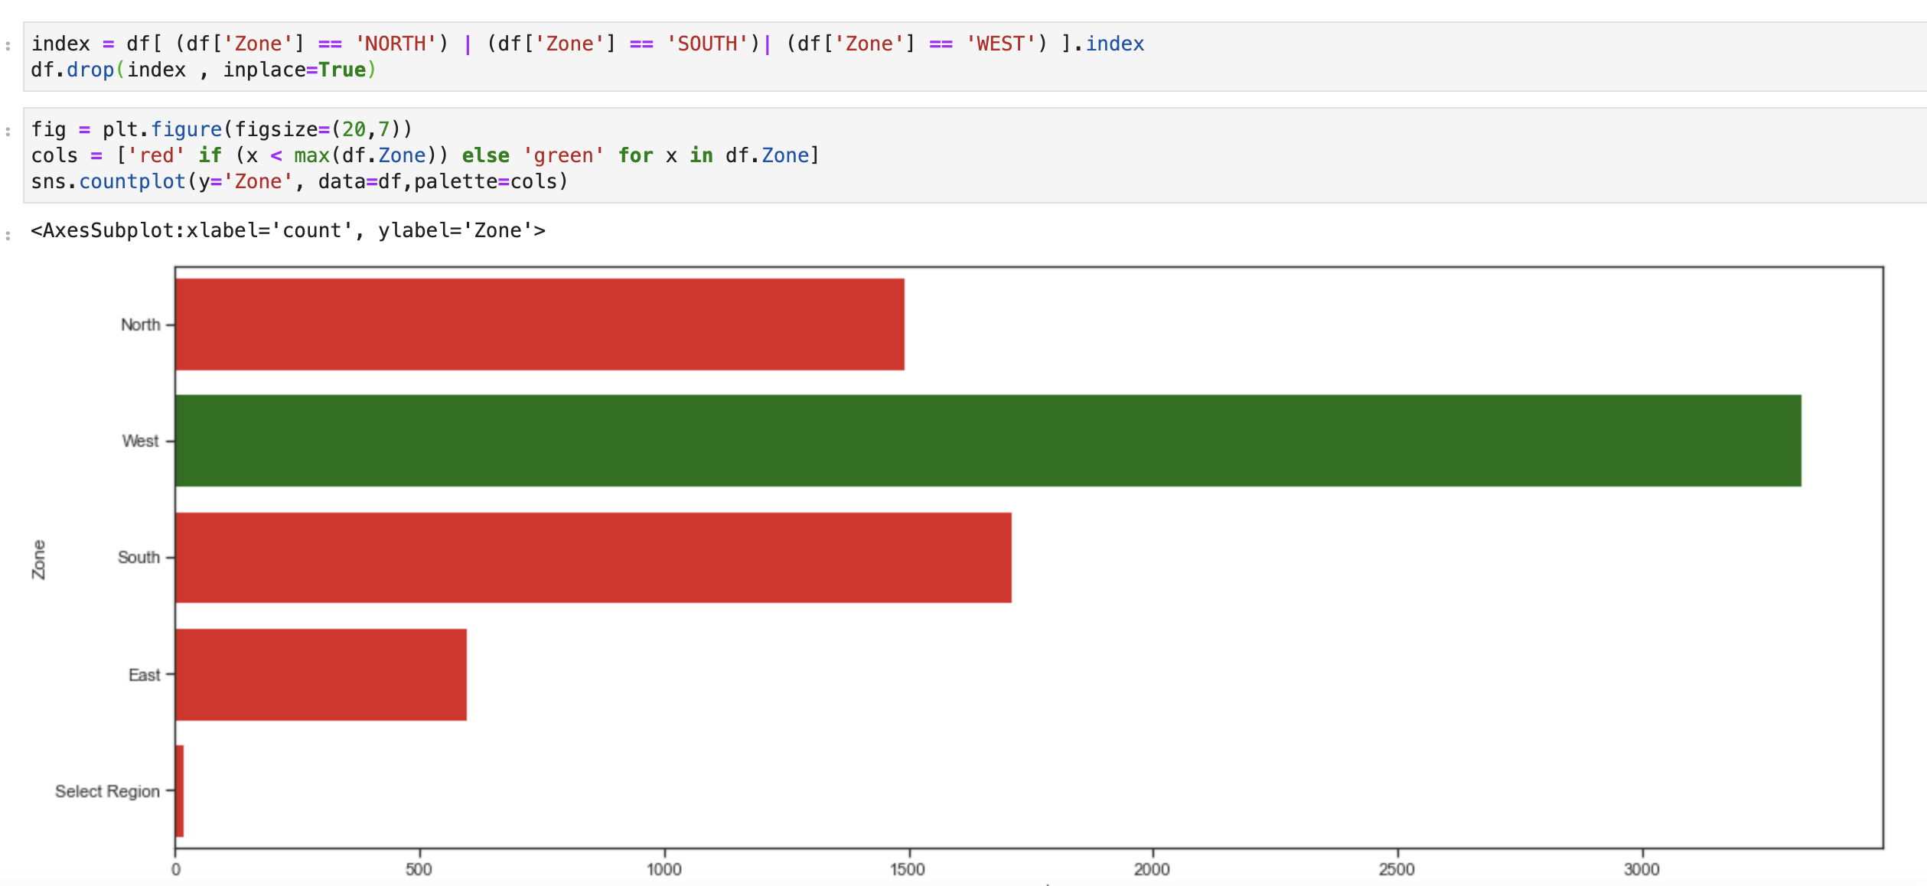
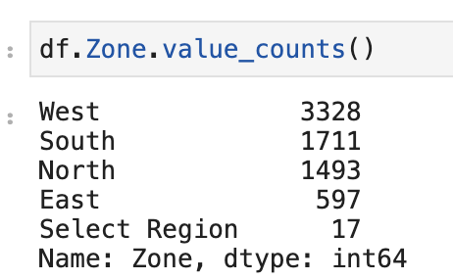
BUSINESS
QUESTIONS
How do warranty claims vary by geography?
By analyzing warranty claims by geography, businesses can identify
potential issues with product distribution or customer demographics that
may be contributing to warranty claims.
PROJECT ONE
08
page

Slide 9
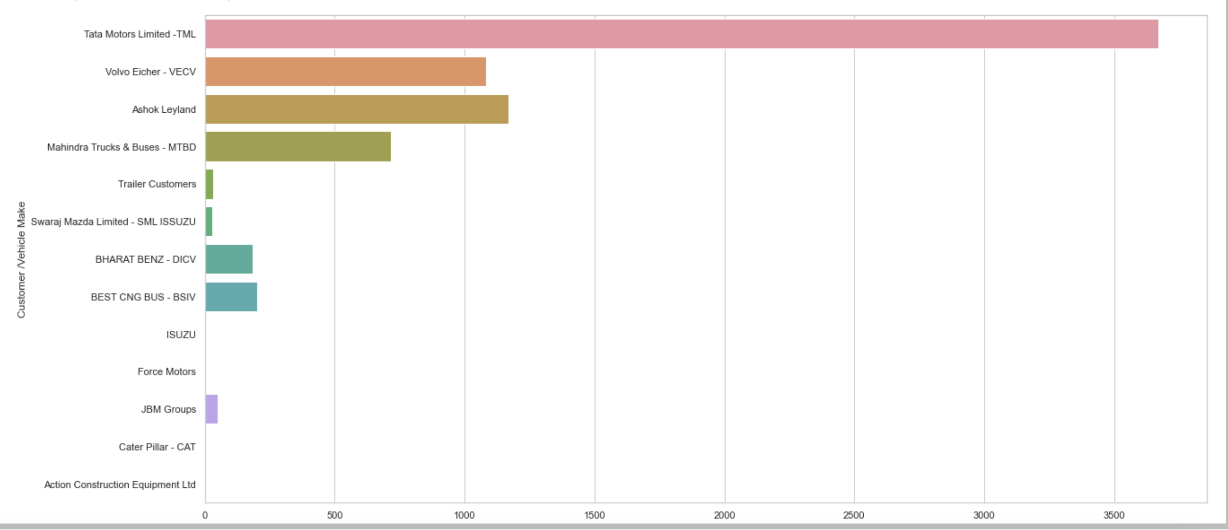
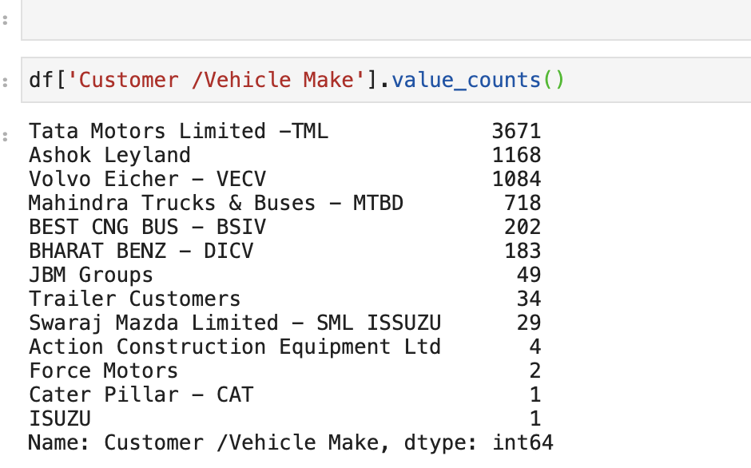
BUSINESS
Which Vehicle Claim The Most Under The Warranty Portal Of ASC?
QUESTIONS
PROJECT ONE
Here Tata Motors Limited Have Contributed A Lot Around 3671, and Last One was ISUZU which contributed less .Which Means It has Less Warranty Claim Than Tata Motors.
09
page

Slide 10
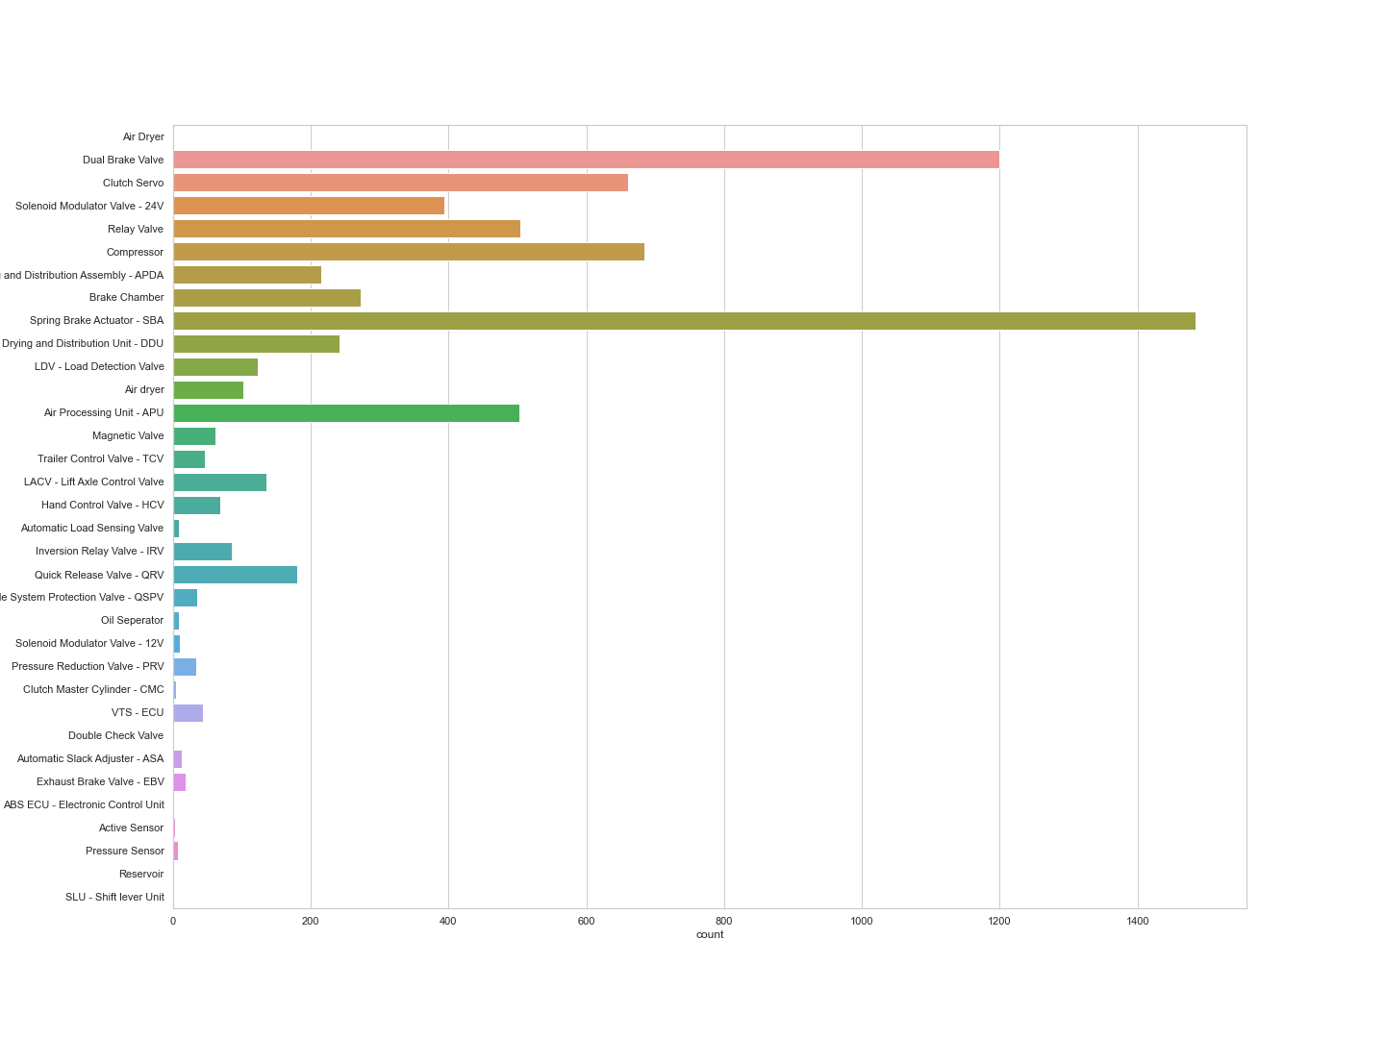
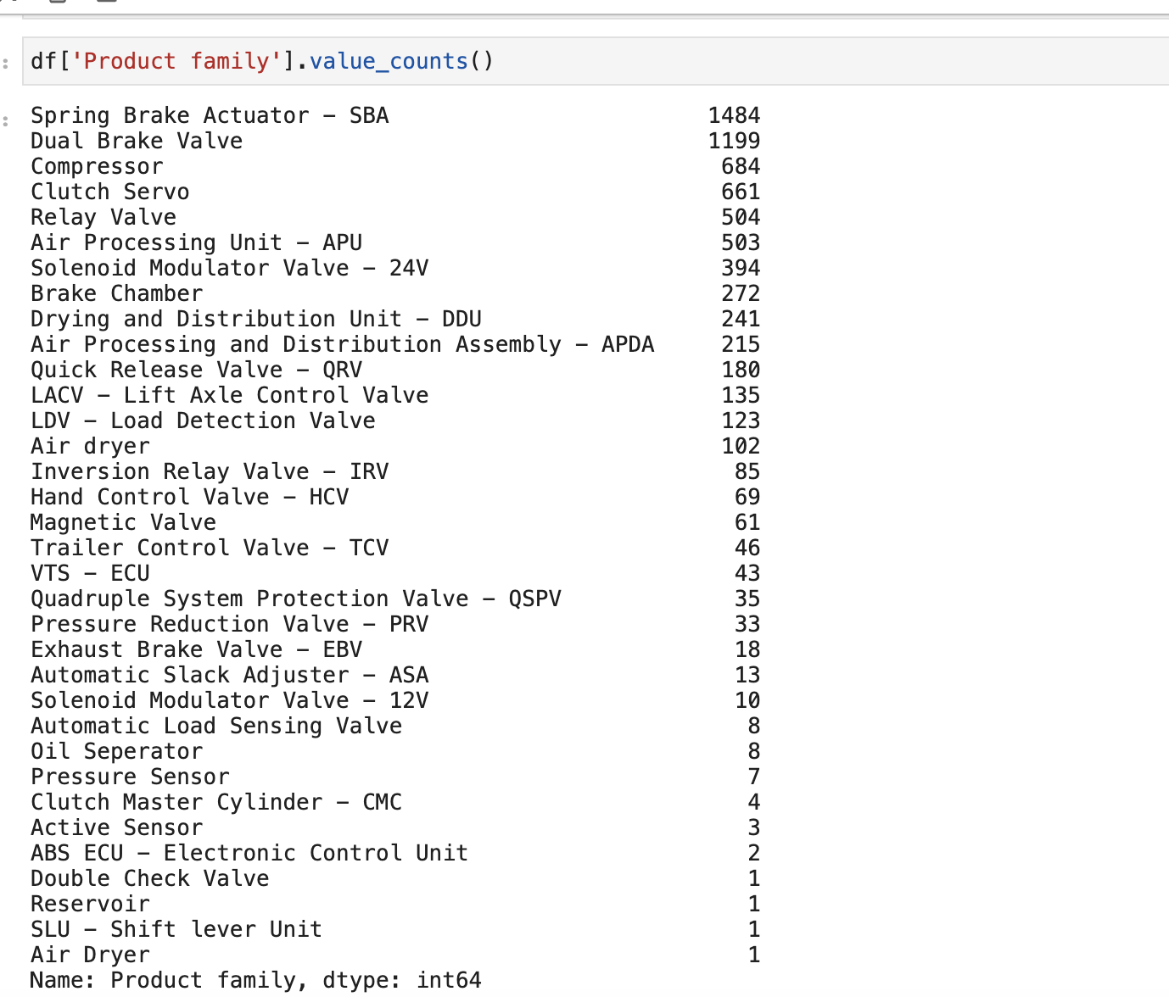
BUSINESS
What are the top reasons for product returns under warranty?
QUESTIONS
PROJECT ONE
10
page

Slide 11
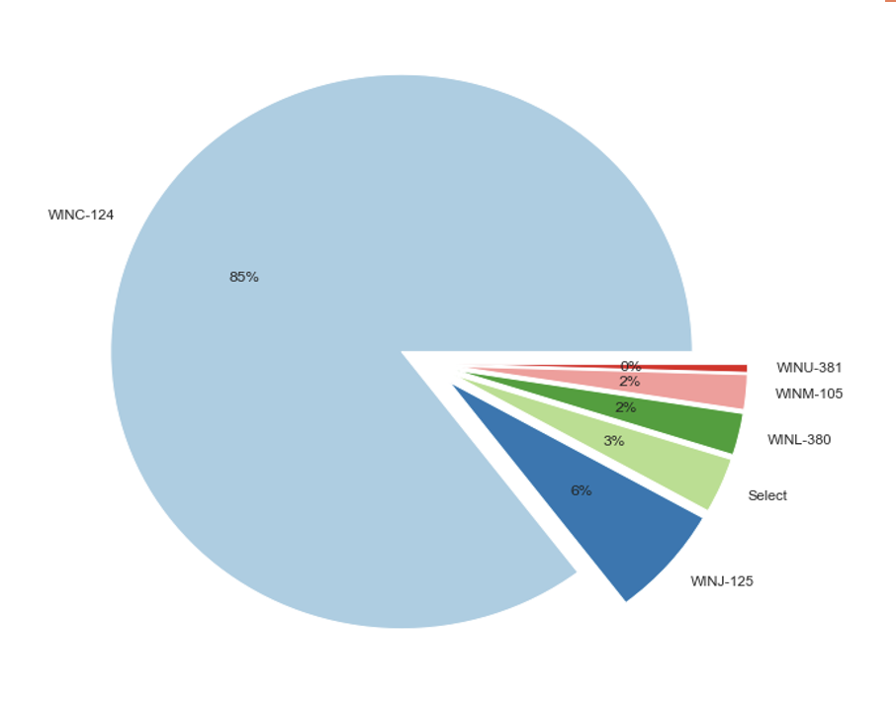
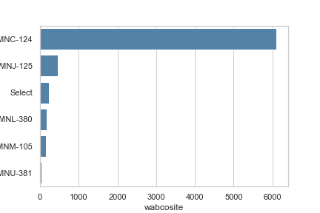
BUSINESS
How to Reduce warranty claims to zero and NCC cost to less than 0,1% ?
QUESTIONS
PROJECT ONE
11
page

Slide 12
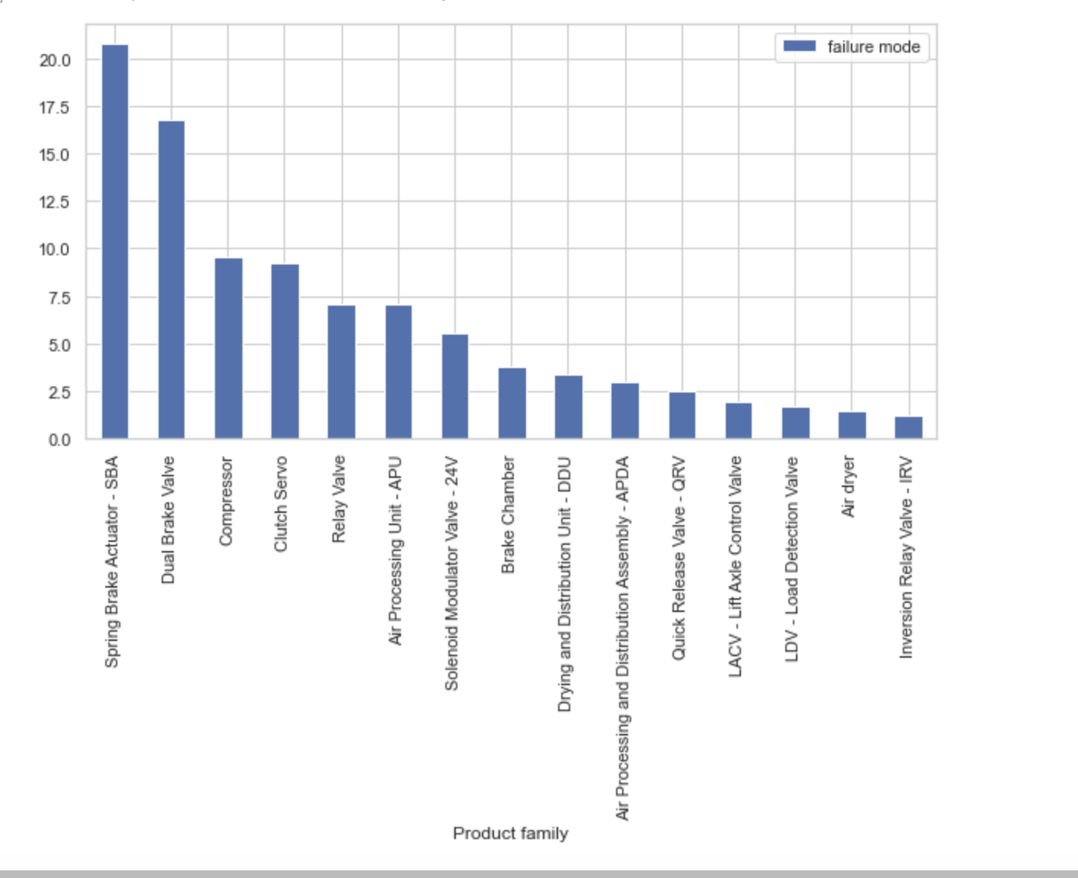
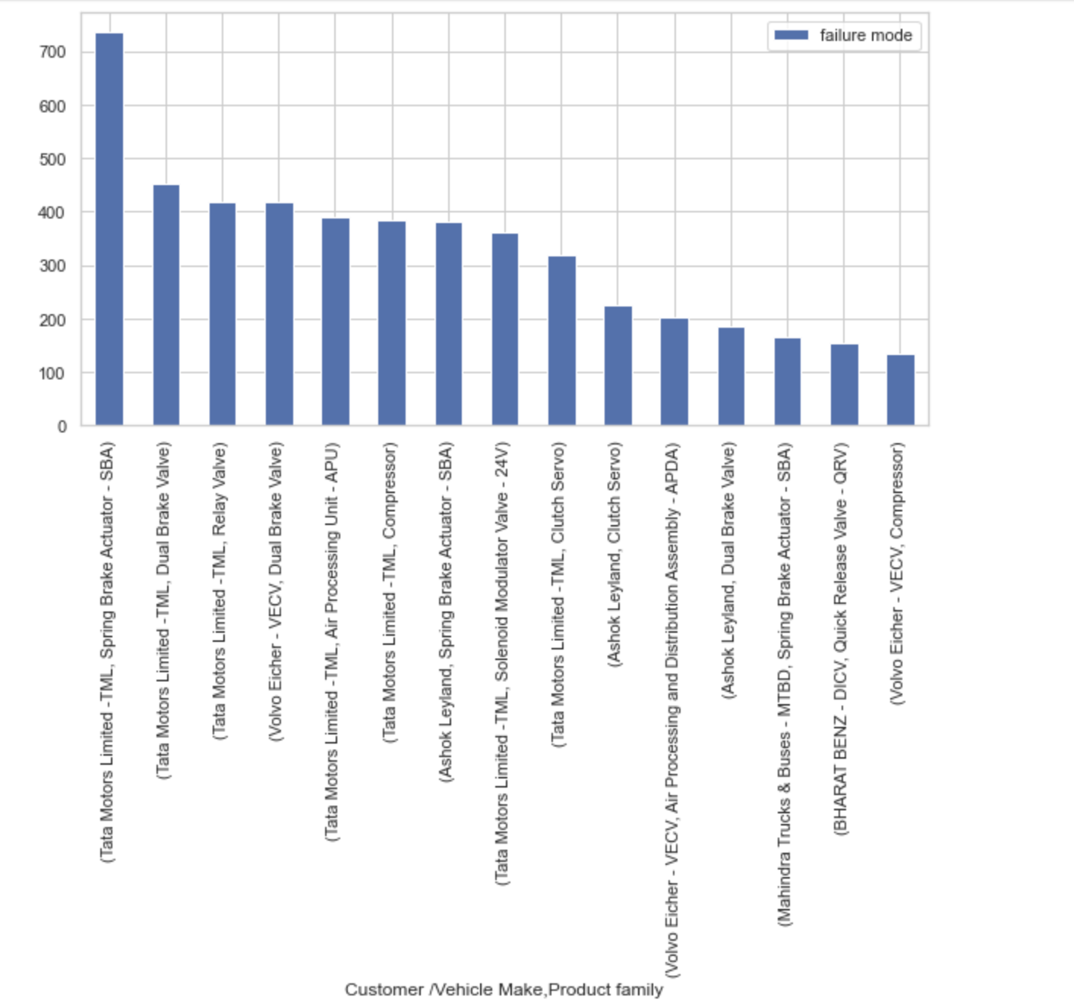
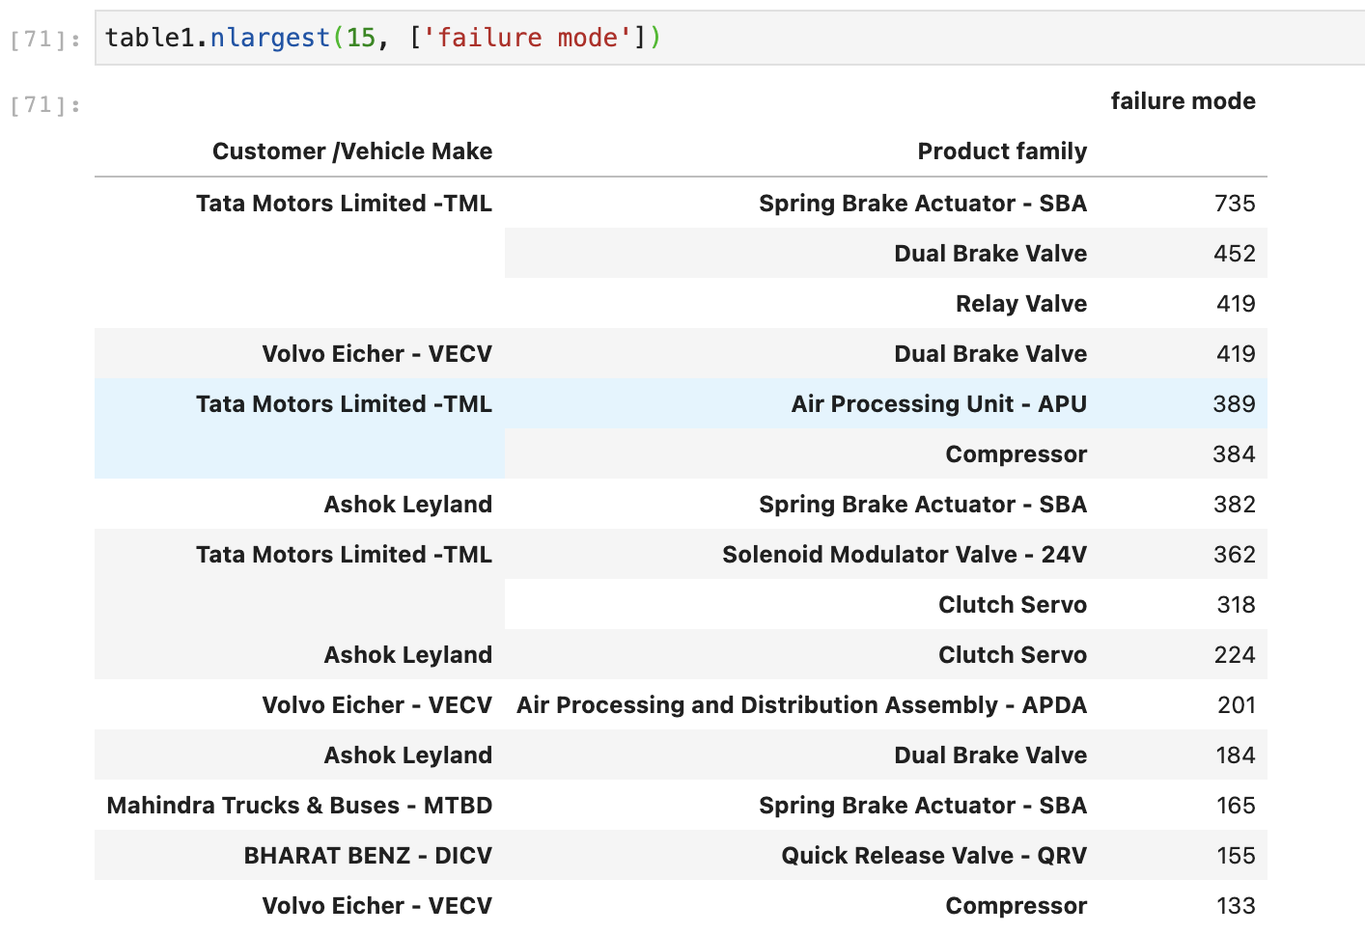
BUSINESS
Which products are contributing more?
QUESTIONS
PROJECT ONE
12
page

Slide 13

PROJECT
RECOMMENDATION
COST
CONTROL
RESOURCE
PLANNING
As far as our analysis on the data grouped by the cities we find that city MUMBAI has highest warranty claim what we suggest is to make a road check on the city MUMBAI to ensure either the defect is on the product or because of the climate and road conditions of the West Region. Monitor and analyze regional and customer segment differences in warranty claims to identify areas for targeted improvements.
Collaborate with suppliers to improve the quality of raw materials and components used in production to reduce the occurrence of defects that lead to warranty claims.
Implement a comprehensive warranty database to better track and analyze warranty claim trends over time and identify areas for improvement.
COST
BUDGETING
COST
ESTIMATING
13
page

Slide 14

DEFINE
CONCLUSION
CONCLUSION
we have identify the top failure modes for the spare parts and determine the root causes of these failures. Makers can then take steps to improve the design and manufacturing processes to reduce the occurrence of these failures and, in turn, reduce warranty claims.
CONCLUSION
we have determine the areas where quality improvements are needed. Manufacturer can then take steps to improve the design, manufacturing, and quality control processes to reduce the occurrence of these issues and improve customer satisfaction.
14
page

Slide 15

OUR TEAM
COST
CONTROL
ANUSH BHARATHWAJ L
DHATCHANA H
BALAMURUGAN B
HIRTHICK RAJ M
DHINAKARAN D G S
ABISHEK V
COST
BUDGETING
COST
ESTIMATING
15
page

Slide 16
THANK YOU

